Slide 1
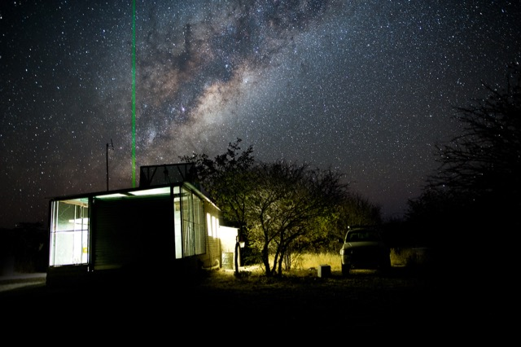
MPLNET Aerosol Lidar Ratios:
background, studies, and new diurnal climatologies
Ellsworth J. Welton, NASA GSFC
Network Manager & Engineer:
Sebastian Stewart, SSAI GSFC Code 612
Data Processing:
Larry Belcher, SSAI GSFC Code 612
Programmer/Web Support: Vacant
Science Team:
James Campbell, Naval Research Lab
Jasper Lewis, UMBC GSFC Code 612
Simone Lolli, CNR, Italy
Administrative Support:
Lisa Nalborczyk, SSAI GSFC Code 612
AERONET & Synergy Tool Partnership:
Brent Holben, NASA GSFC Code 618
Dave Giles, NASA GSFC Code 618
NASA SMARTLABS Field Deployments:
Si-Chee Tsay, NASA GSFC Code 613
Site Operations & Science Investigations
…. many network partners around the world
MPLNET is funded by the NASA Radiation Sciences
Program and the Earth Observing System
Windpoort, Namibia (borders Etosha Nat Park)
Photo: Seb Stewart

Slide 2


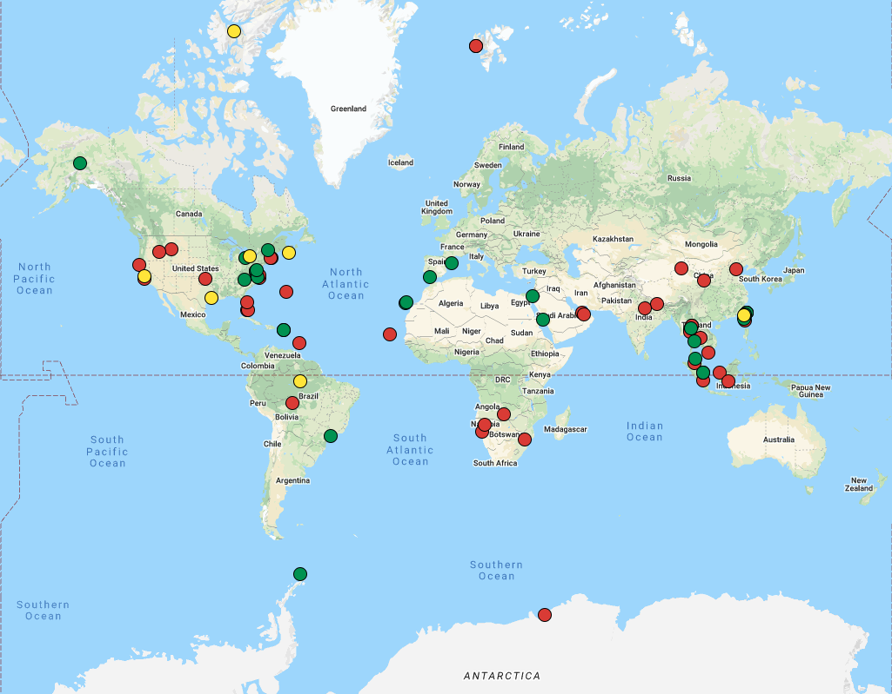
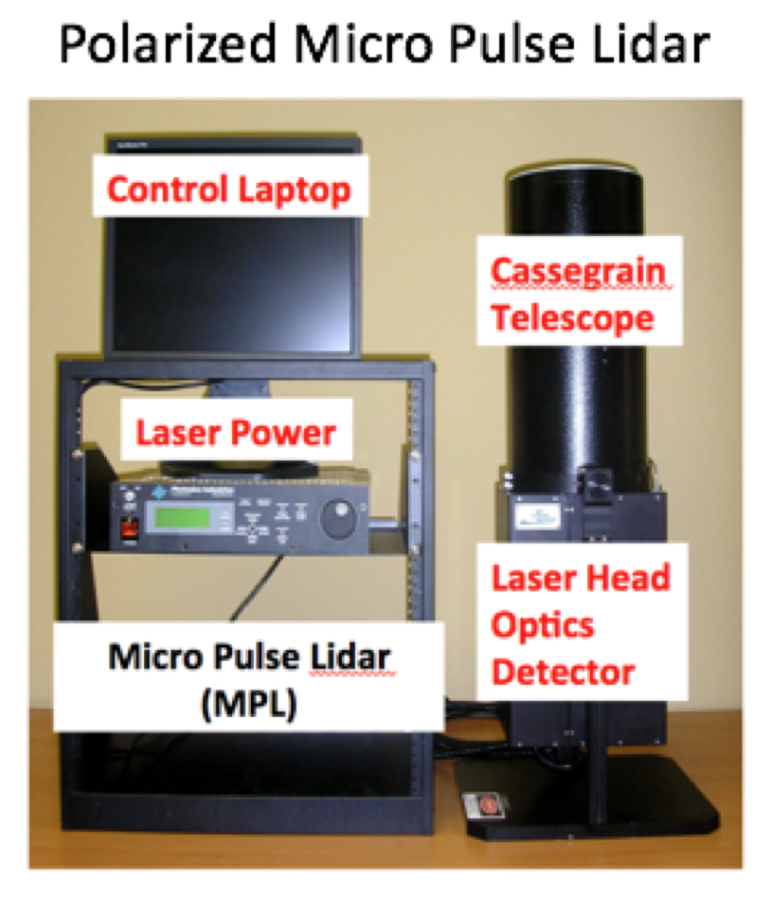
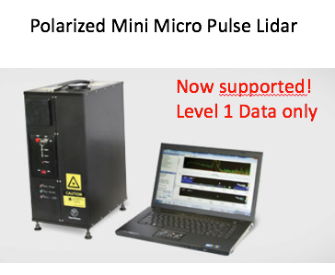
MPLNET: Overview
Global Backscatter Lidar Network: 2000 - current
75 sites total (25 active, 50 inactive). 27 countries, 45 partners.
7 more planned sites
Continuous (day/night) operations
97% of network co-located with AERONET
Created using AERONET model: federated network with centralized and standardized calibration, processing, distribution. Same open data policy (with co-authorship offer).
Instrumentation:
Micro Pulse Lidar (NASA developed, commercial since 1995)
Eye safe, green backscatter lidar. Polarized in early 2000s
Entire network has polarized MPL since ~2016
MPLNET Sites: 2000 - current
Active
Inactive
Planned

Slide 3
MPLNET: Data Products
Data Products:
Versions: V1 (2000-2006), V2 (2006-2015), V3 (2016-current)
All data (2000-current) are being reprocessed in V3 now
Product suite: Signals/diagnostics (NRB), Cloud (CLD), Aerosol (AER), Boundary Layer (PBL)
New precipitation product in development
Levels: L1 (NRT, no QA), L1.5 (NRT, QA), L2 (final QA)
Format: netcdf4, CF compliance
Granule: 1 Day. 1 min temporal, 75 m vertical. 0-30 km altitude.
Data Center: https://mplnet.gsfc.nasa.gov
Signals
Cloud Phase Mask, Aerosol Backscatter, Mixed Layer Height
Water Clouds Mixed Phase Clouds Ice Clouds Mixed Layer Height
Many more variables available for each product than shown here:
https://mplnet.gsfc.nasa.gov/product-info/

Slide 4
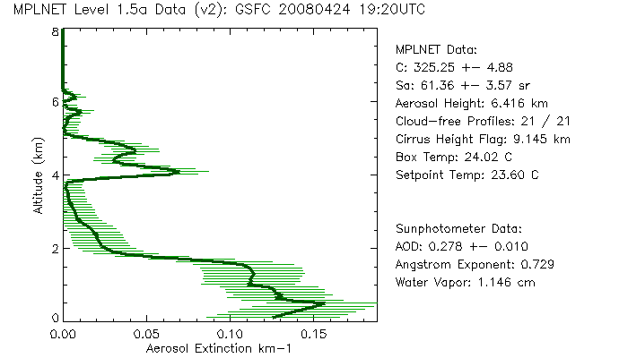
MPLNET: Aerosol Data Product
Data Products:
Versions: V1 (2000-2006), V2 (2006-2015), V3 (2016-current)
All data (2000-current) are being reprocessed in V3 now
Product suite: Signals/diagnostics (NRB), Cloud (CLD), Aerosol (AER), Boundary Layer (PBL)
New precipitation product in development
Levels: L1 (NRT, no QA), L1.5 (NRT, QA), L2 (final QA)
Format: netcdf4, CF compliance
Granule: 1 Day. 1 min temporal, 75 m vertical. 0-30 km altitude.
Data Center: https://mplnet.gsfc.nasa.gov
Aerosol Products:
MPLNET has a long history with aerosol retrievals
Pre-MPLNET ACE-2 Campaign 1997: Welton et al 2000 demonstrate constrained AOD approach with MPL
Aerosol Properties:
Retrievals at coincident AERONET AOD observations
Using constrained Fernald solution: integral of extinction = AOD
(Welton et al. 2000)
Algorithm calculates the lidar calibration value (C), backscatter and extinction profiles, and a column average lidar ratio*
* The relevance is that if different aerosol “types” are stratified in different layers, then the MPLNET lidar ratio will be a weighted average of all.
Series of papers validating MPLNET extinction profile retrievals against Ames Airborne Tracking Sunphotometer
This indirectly validates the retrieved aerosol lidar ratio
Culmination: Schmid et al 2006: State of the art aerosol extinction measurement intercomparisons
  MPLNET met the average bias, and exceeded some other techniques

Slide 5
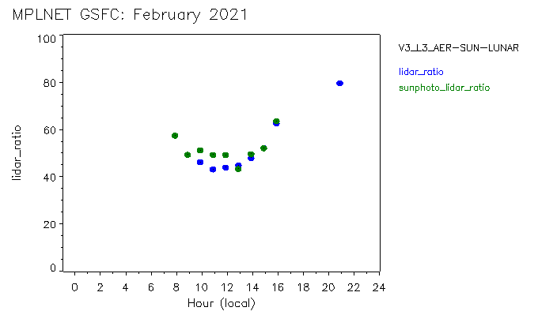
MPLNET is 21 years old! She can drink legally, and has a lot of stories to tell
Exploit Diurnal Capability of MPLNET
12 sites with 10+ years of data
10 sites with 5 – 9 years of data
2 sites with 20+ years of data (GSFC and South Pole)
We are developing L3 products for the first time
  Standard L3 product files will be monthly diurnal averages for full product suite (NRB, CLD, AER, PBL)
  Custom L3 products will be developed for EarthCARE and other satellite missions, and modeling support
Construct Monthly, Seasonal, and Annual Diurnal Climatologies
AERONET Lidar Ratio
MPLNET Lidar Ratio *
* L1.5 data, no temp correction
Nighttime data dependent upon AERONET Lunar AOD
Methodology:
Regrid L2 daily product files ….
  Granule: 1 Day. 1 min temporal, 75 m vertical. 0-30 km altitude.
….. to L3 monthly diurnal files:
  Granule: 1 Month. 24 hour, 75 m vertical. 0-30 km altitude.
Data Screening:
  Still testing various scenarios
  Initial: minimum of 80% of month with data
  # of obs per variable per hour based on more
  complex formula of days*minutes
  Currently:
    Minimum of 10 days with data per month
    Minimum of 10 observations per variable per hour
Construction of seasonal and yearly L3 results follows same flagging for low statistical significance
Notes:
For yearly: must have data from at least 10 months out of the 12

Slide 6
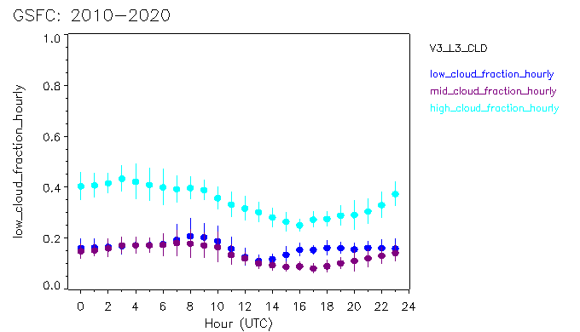
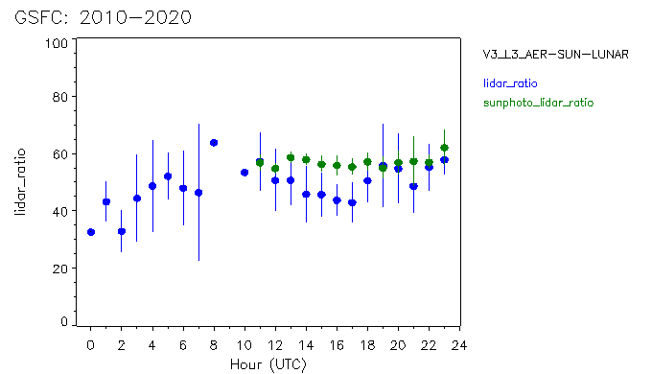
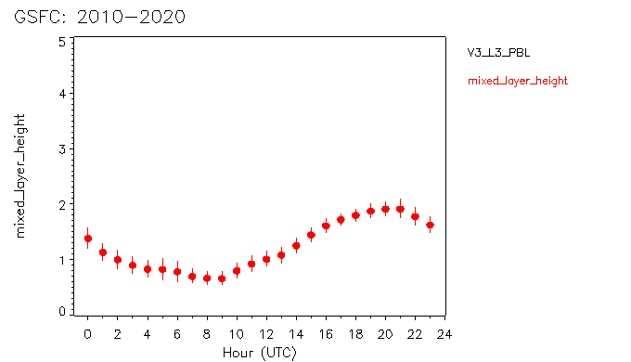
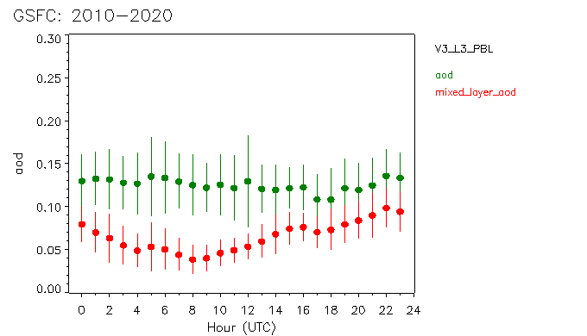
MPLNET Diurnal Climatologies: Decadal Summary 2010 - 2020
Low Cloud Fraction
Mid Cloud Fraction
High Cloud Fraction
Mean sunrise
AERONET Lidar Ratio
MPLNET Lidar Ratio *
Mean sunrise
* L1.5 data, no temp correction
Mixed Layer Height
Mean sunrise
Column AERONET AOD
Mixed Layer AOD
Mean sunrise

Slide 7
MPLNET Diurnal Climatologies: Decadal Summary 2010 - 2020
Low Cloud Fraction
Mid Cloud Fraction
High Cloud Fraction
Mean sunrise
AERONET Lidar Ratio
MPLNET Lidar Ratio *
Mean sunrise
* L1.5 data, no temp correction
But how useful would these lidar ratios be for CALIPSO after being thrown into a big averaging bucket?
The 10 yr average looks nothing like the monthly results from Feb 2021
The monthly averages will differ from daily.
Extrapolating site results to a region will compound these problems.
Is more detailed analysis required with a different presentation of the results?
There have been about 30 MPLNET papers that included analysis of aerosol lidar ratios (but only 2 as the focus)
This work has tapered off in recent years as we’ve shifted to cloud studies, good to be back on aerosol ….
Here we’ll focus on MPLNET papers with lidar ratio data from under-sampled regions.
Asia (as requested by CALIPSO staff)
Southern Africa (which is also under-sampled)
Mixed Layer Height
Mean sunrise
Column AERONET AOD
Mixed Layer AOD
Mean sunrise

Slide 8
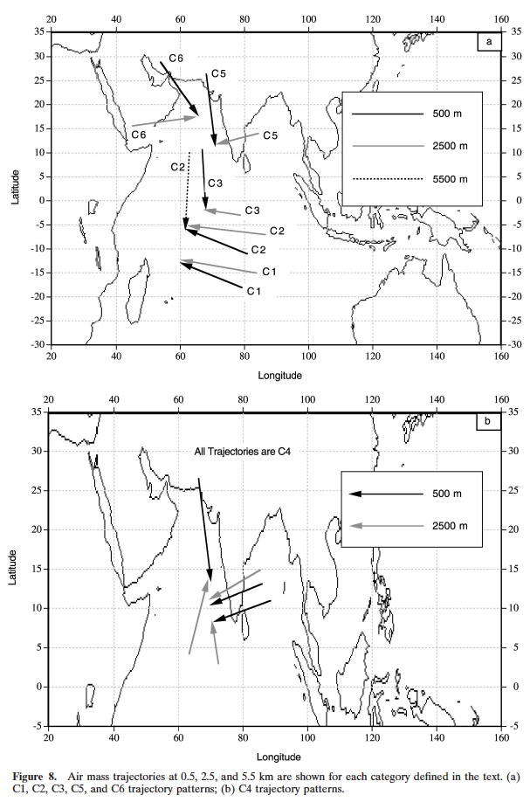
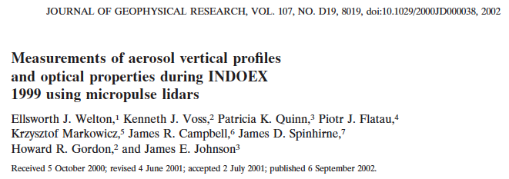
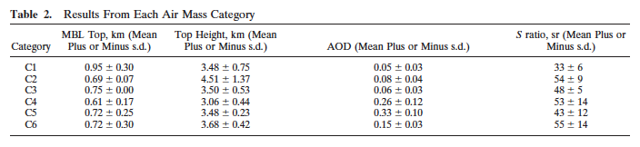
Pre-MPLNET INDOEX Study 1999: Indian Ocean
Shipboard study of aerosol properties over the Indian Ocean, primary outflow from India.
Quinn et al, 2002 provide airmass characterizations for the INDOEX cruise
Results for each airmass category are provided below:

Slide 9
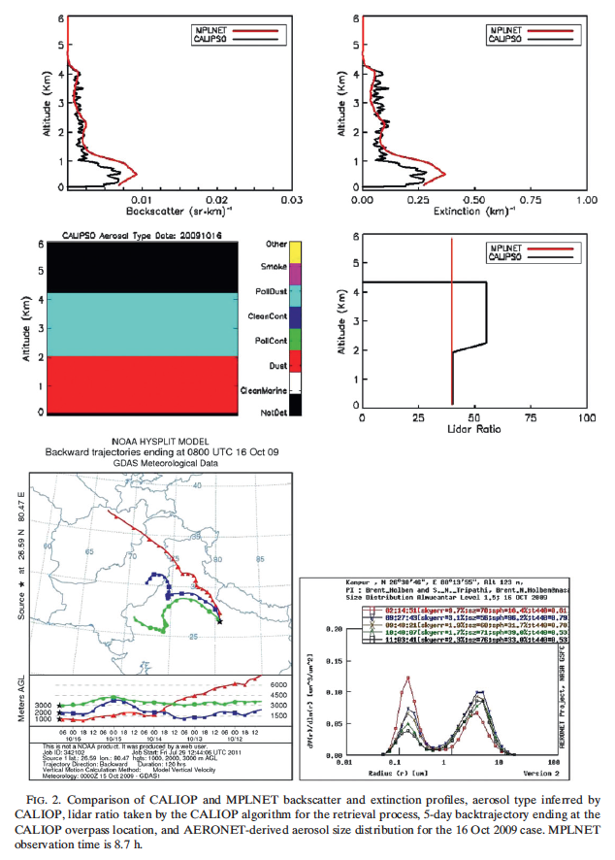
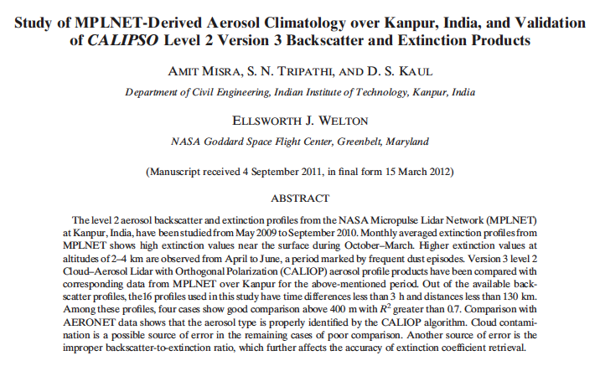
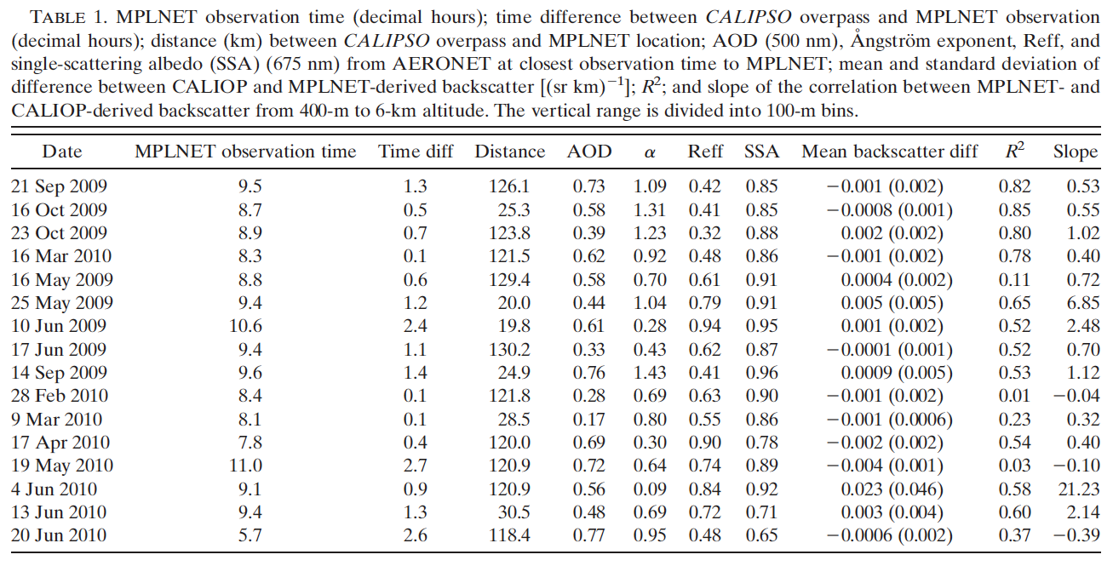
MPLNET Kanpur, India Study 2009-2010: CALIPSO Validation
Misra, et al, 2012. J. Atmos. Oceanic Technol., 29, 1285–1294
MPLNET V2 data
CALIPSO V3 data

Slide 10
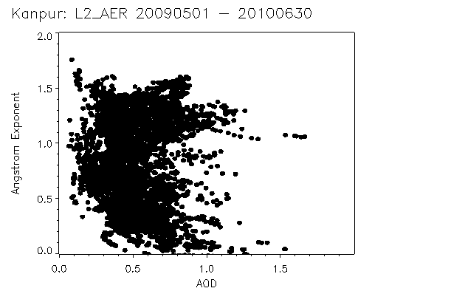
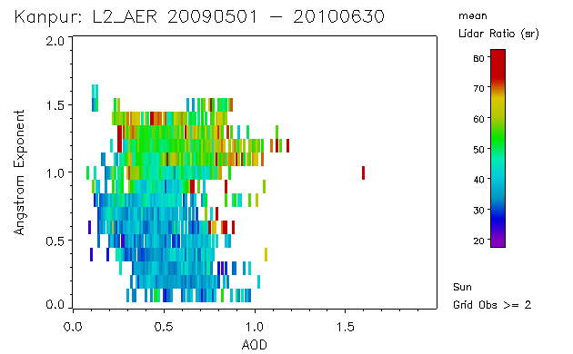
MPLNET Kanpur, India Study 2009-2010: CALIPSO Validation
Misra et al did not table or categorize the lidar ratio values, they are just in the text.
Here I’ve plotted the MPLNET V2, L2 Lidar Ratios vs AERONET AOD and Angstrom Exponent for this period.
Lidar Ratio
55 + 14 sr
39 + 10 sr
Ang Exp: 1.0

Slide 11
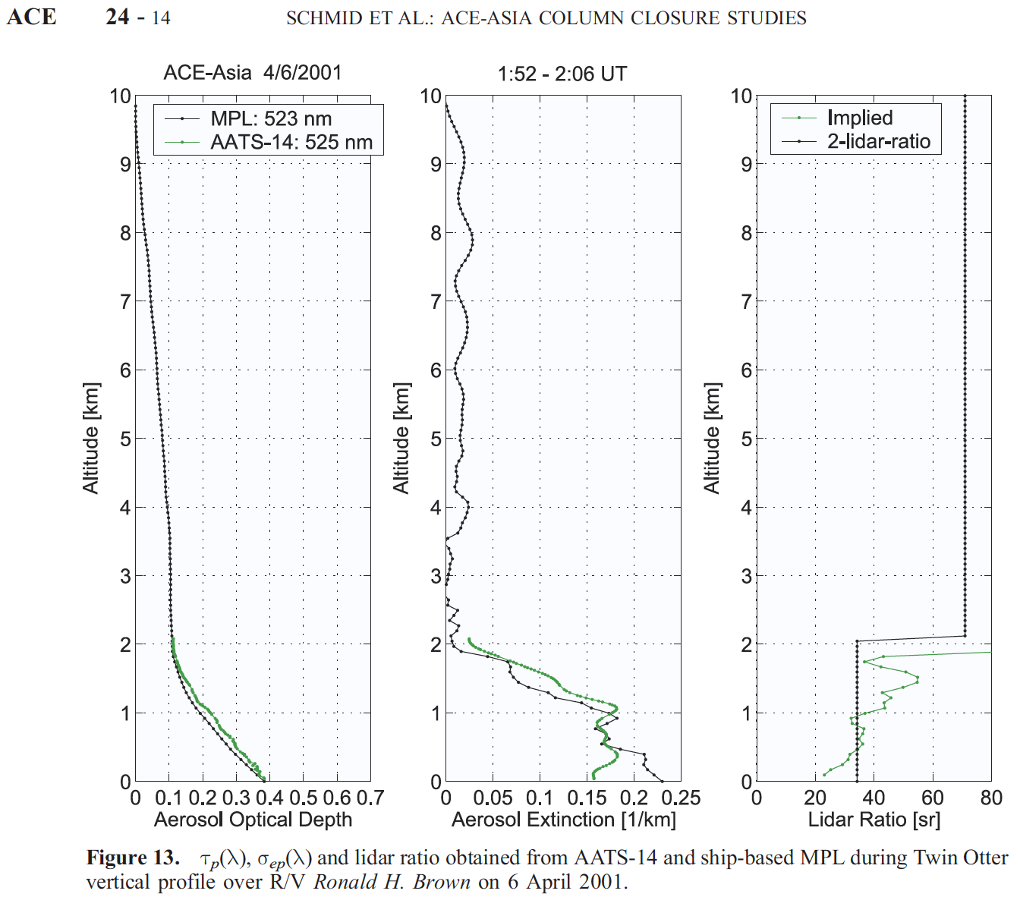
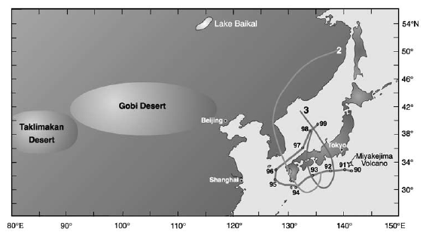
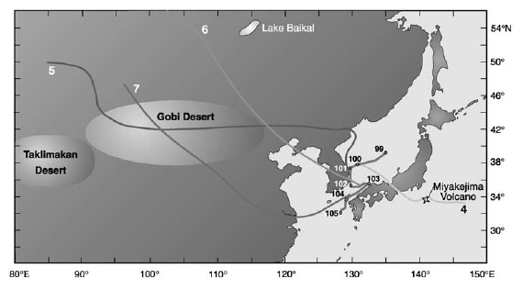
MPLNET results from the ACE Asia Research Cruise in 2001
Quinn, et al, 2004: Aerosol Optical Properties Measured Onboard the Ronald H. Brown During ACE Asia as a Function of Aerosol Chemical Composition and Source Region, J. Geophys. Res., 109, D19S01, doi:10.1029/2003JD004010.
Cruise air mass categorization and shipboard in-situ data
Schmid, et al, 2003: Column closure studies of lower tropospheric aerosol and water vapor during ACE-Asia using airborne sunphotometer, airborne in-situ and ship-based lidar measurements, J. Geophys. Res., 108, 8656, doi:10.1029/2002JD003361.
Case study of aerosol closure, including lidar ratio (and implied lidar ratio MPLNET+AATS)
The MPLNET data were analyzed using a modified retrieval process (not standard MPLNET). Here AATS AOD data were used to provide a two-layer constraint to solve for extinction and lidar ratio in each layer separately (2-lidar-ratio on plot to right). In addition, an implied lidar ratio was calculated using the AATS AOD profile and the MPL attenuated backscatter signal.
April 6 case to right: three distinct layers
MBL to 500 m: 25 sr
Mid layer 500 – 2000 m: 45 sr
High layer > 2000 m: 70 sr
Kuzmanoski, et al, 2007: Aerosol properties computed from aircraft-based observations during the ACE-Asia campaign: 2. A case study of lidar ratio closure, Aerosol Sci. Tech., 41, 231-243.
Case study of lidar ratio closure between multiple observation methods

Slide 12
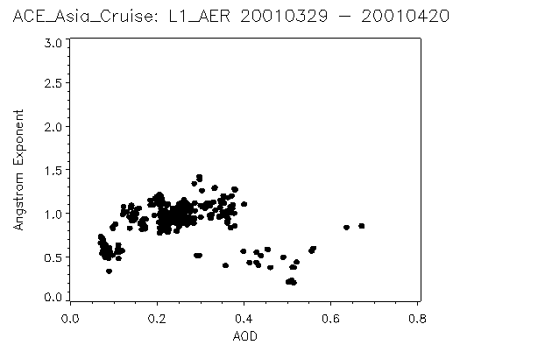
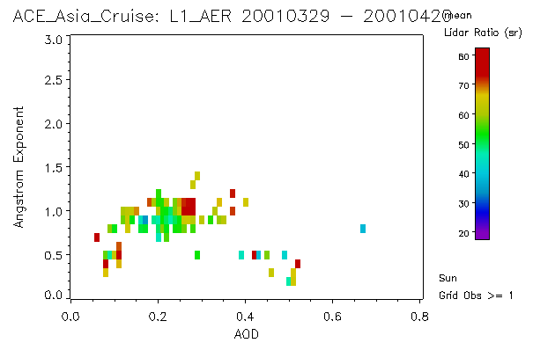
MPLNET results from the ACE Asia Research Cruise in 2001
Schmid, et al, 2003: Column closure studies of lower tropospheric aerosol and water vapor during ACE-Asia using airborne sunphotometer, airborne in-situ and ship-based lidar measurements, J. Geophys. Res., 108, 8656, doi:10.1029/2002JD003361.
Case study of aerosol closure, including lidar ratio (and implied lidar ratio MPLNET+AATS)
Quinn, et al, 2004: Aerosol Optical Properties Measured Onboard the Ronald H. Brown During ACE Asia as a Function of Aerosol Chemical Composition and Source Region, J. Geophys. Res., 109, D19S01, doi:10.1029/2003JD004010.
Cruise air mass categorization and shipboard in-situ data
Kuzmanoski, et al, 2007: Aerosol properties computed from aircraft-based observations during the ACE-Asia campaign: 2. A case study of lidar ratio closure, Aerosol Sci. Tech., 41, 231-243.
Case study of lidar ratio closure between multiple observation methods
These papers were case studies, and did not provide a comprehensive overview of the MPLNET measurements during the cruise. A graduate student was going to write a paper on the data but was not finished.
Here I’ve reprocessed the older MPLNET Version 2 data in our new Version 3 system. The AOD constraints are from microtops, not AERONET (also pre-dates MAN). Some potential for thin cirrus contamination.
Lidar Ratio
59 + 11 sr
64 + 9 sr
55 + 11 sr
Ang Exp: 1.0

Slide 13
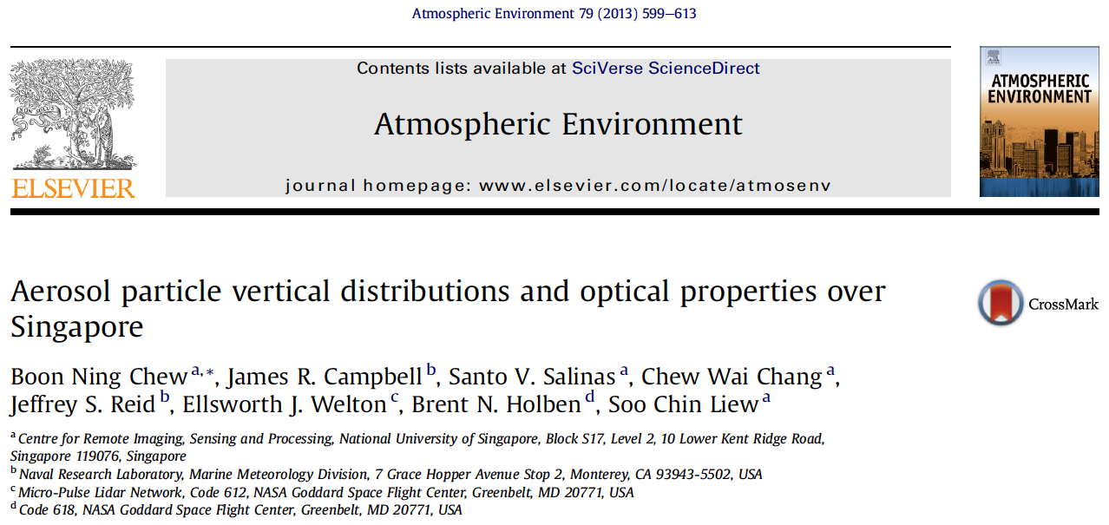
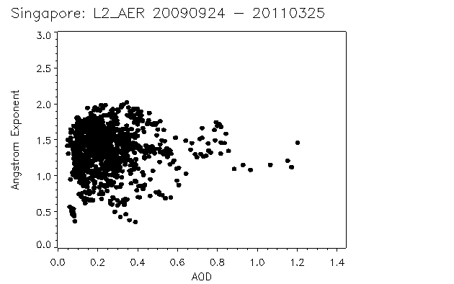
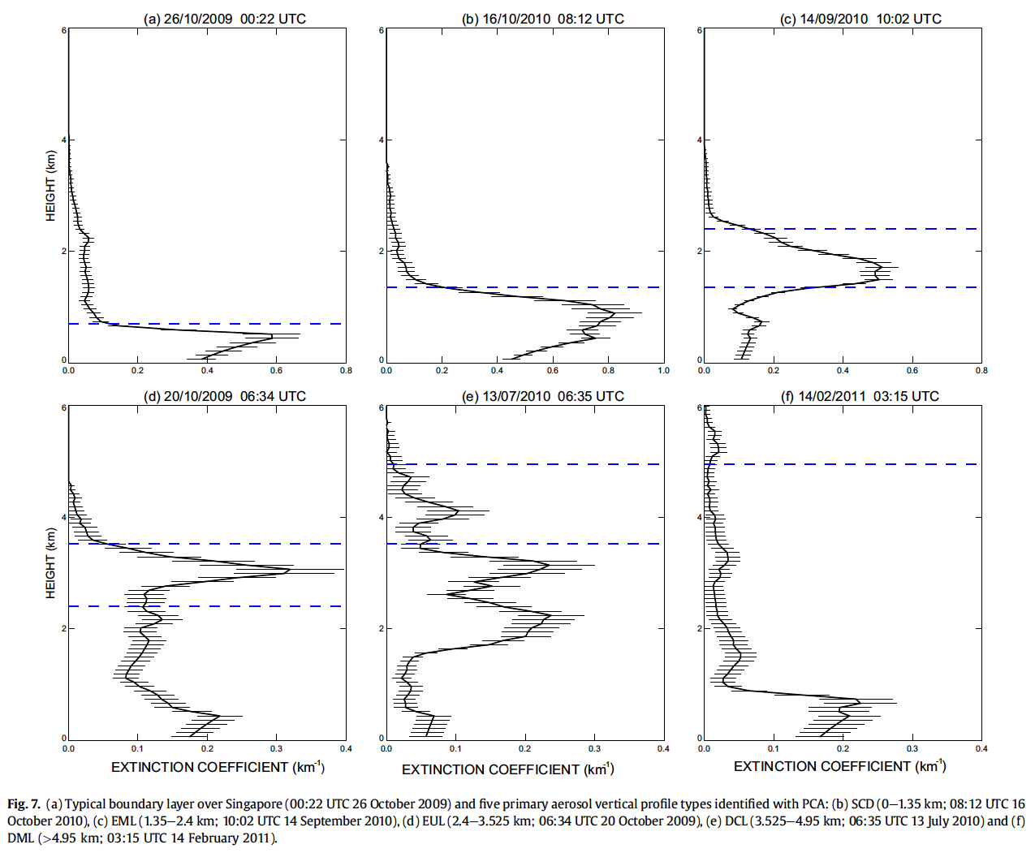
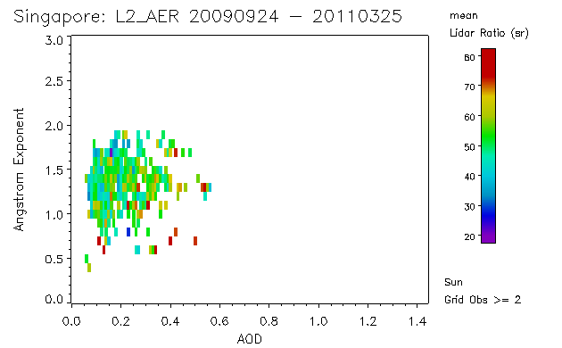
MPLNET Singapore Aerosol Characterization Study: 2009-09-24 to 2011-03-25
Principal Component Analysis: 5 aerosol profile types
Typical boundary layer
(for comparison)
strongly-capped/
deep near-surface layer
enhanced mid-level layer
Unfortunately, other aerosol parameters were not listed by PCA type (including lidar ratio). I will have to contact lead author.
Lidar Ratio
52 + 12 sr
Meantime, I’ve provided plots of the MPLNET V2 lidar ratio data for this time period.
enhanced upper-level layer
deep contiguous layer
deep multi-layer

Slide 14
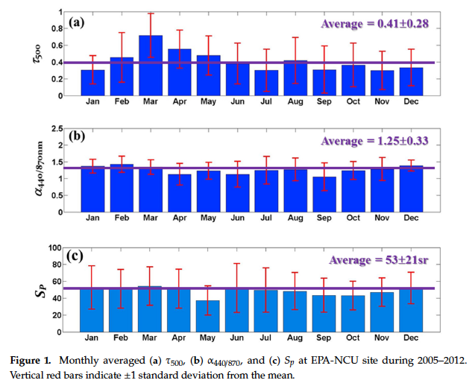
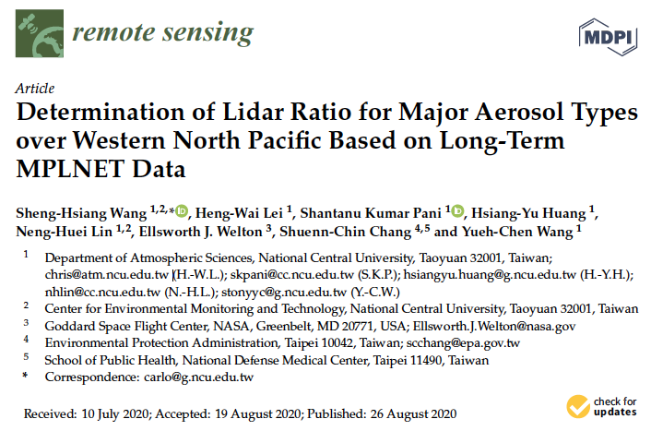
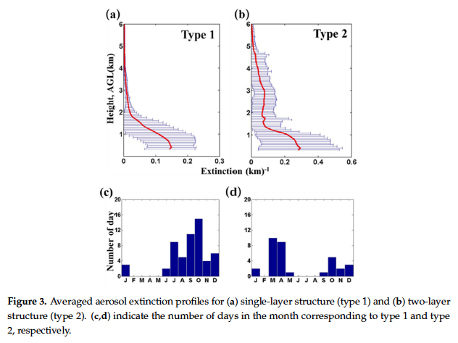
MPLNET Long-term Taiwan Lidar Ratio Study: 2005 - 2012
AOD
Angstrom Exponent
Lidar Ratio
Following on several SE Asian field experiment papers and case studies, the lead authors analyzed 7 years of MPLNET data from the EPA-NCU site in Northern Taiwan.
Monthly averages of AOD, Angstrom Exponent, and Lidar Ratio
Analysis was broken into studies of single and double layer aerosol events (Type 1 and 2).
Biomass Burning Transport

Slide 15
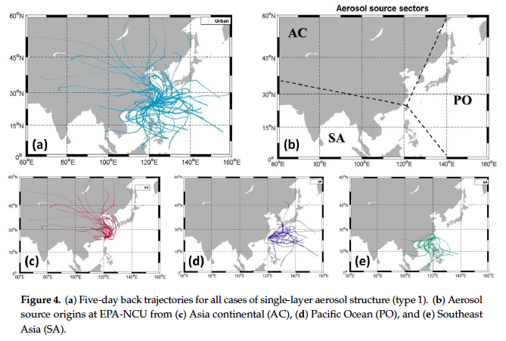
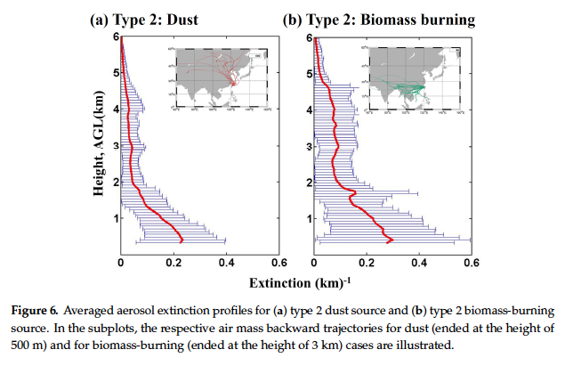
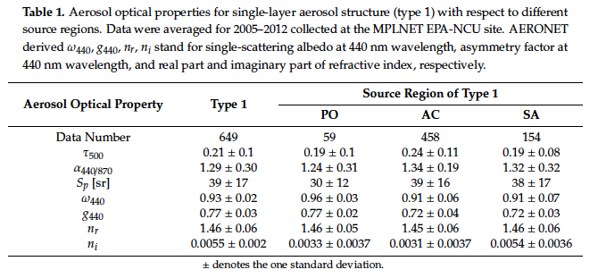
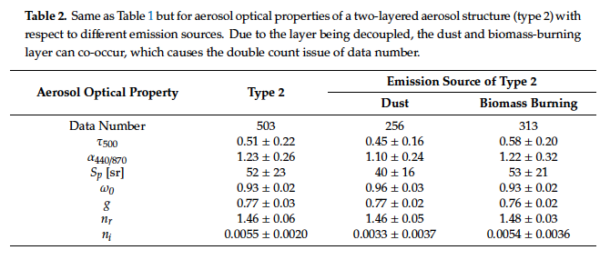
MPLNET Long-term Taiwan Lidar Ratio Study: 2005 - 2012
Type 1: Single Layer Results Type 2: Two Layer Results
These are not pure species, but mix with local and/or marine aerosol
Marine

Slide 16
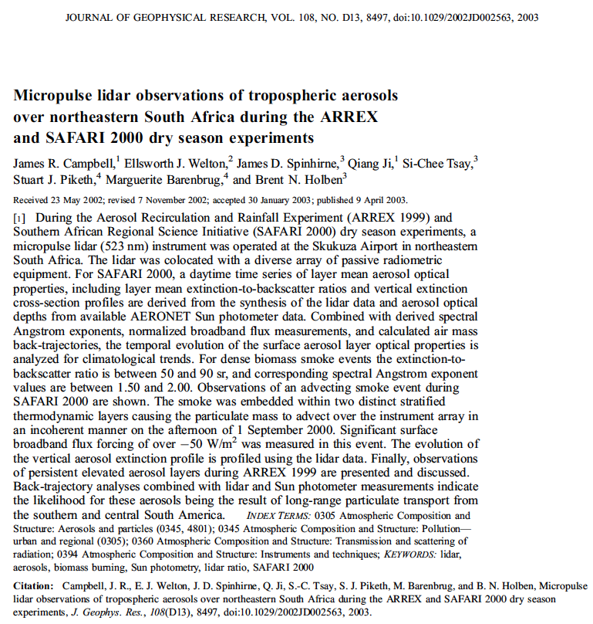
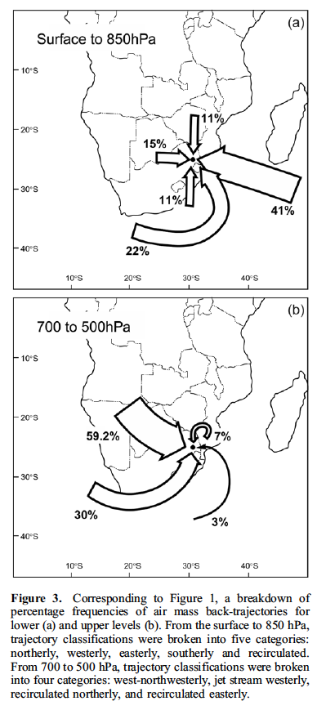
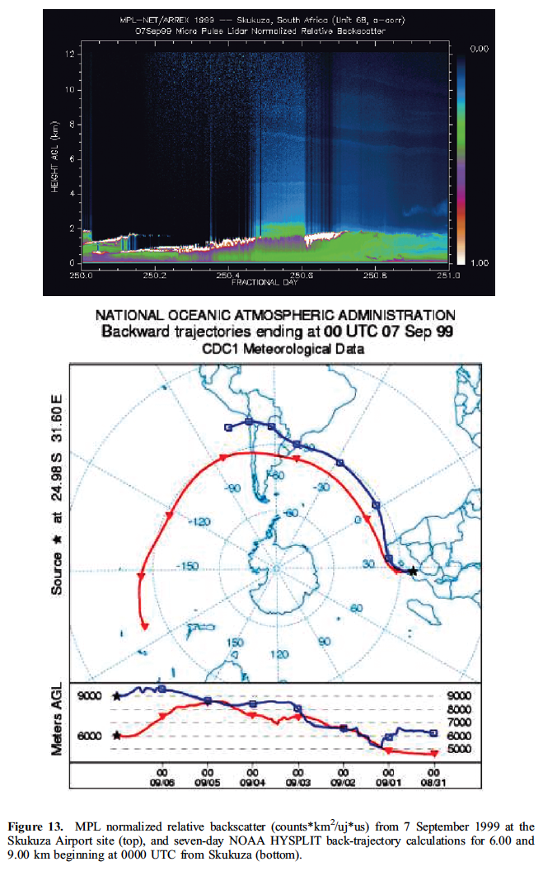
MPLNET SAFARI 2000: Southern Africa
SAFARI 1999: Skukuza Sept 7, 1999
Mongu, Zambia
Windpoort,
Namibia
Skukuza, S Africa
Two MPLNET sites in the region:
Skukuza, South Africa
Mongu, Zambia
Southern Africa gyre transports & recirculates aerosol
Complex mixture of pollution, smoke, and dust aerosols

Slide 17
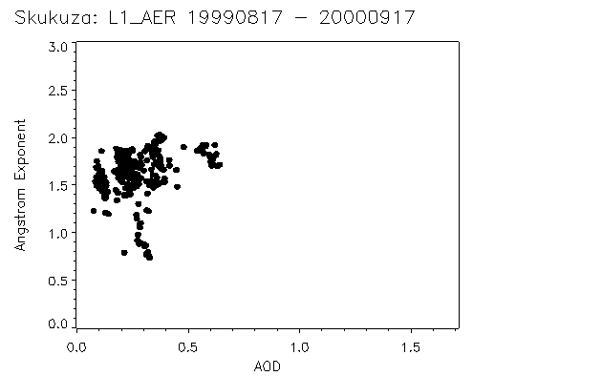
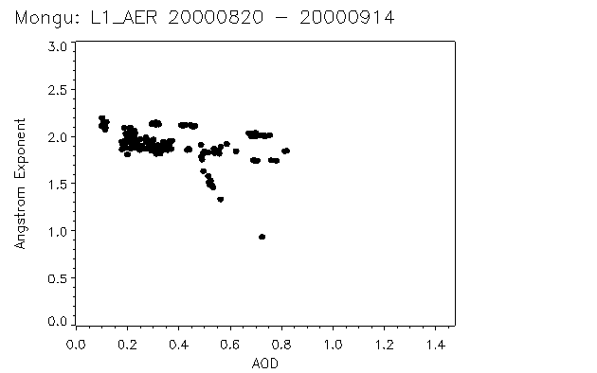
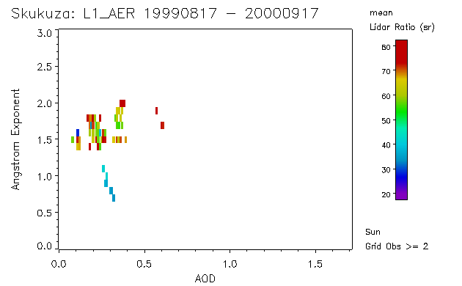
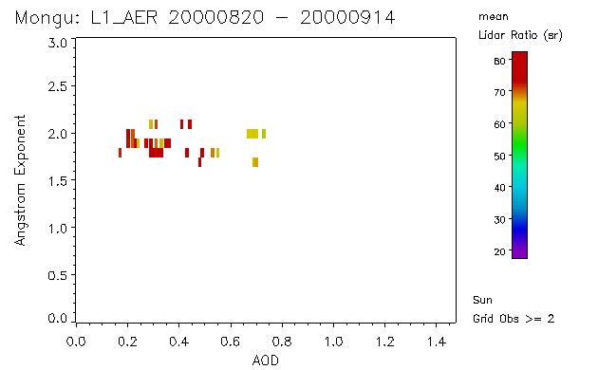
MPLNET SAFARI 2000: Southern Africa
Lidar Ratio
65 + 10 sr
37 + 3.4 sr
Lidar Ratio
71 + 6 sr
Ang Exp: 1.25
Original study was not focused on lidar ratio.
I have further QA screened the old SAFARI data with more modern methods.

Slide 18
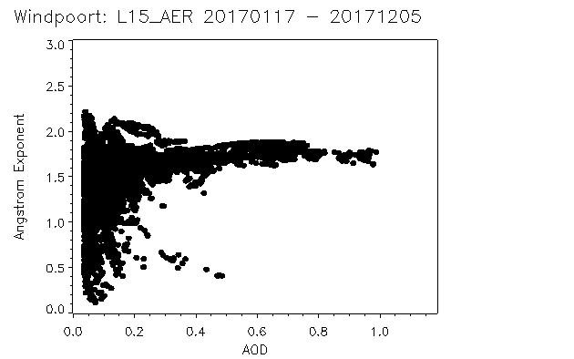
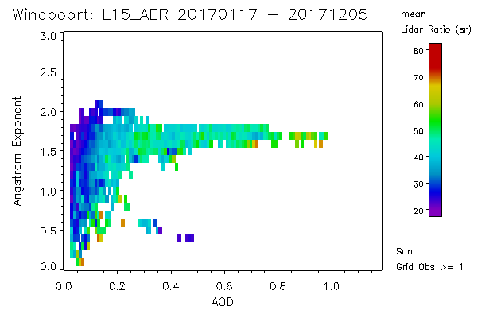
MPLNET Windpoort, Namibia: Southern Africa
Arid desert high plateau site (~ 1 km). Next to Etosha Nat. Park
Despite appearing as a ”dust” site, very complex aerosol from Southern African transport.
Lidar Ratio
46 + 7.5 sr
35 + 13 sr

Slide 19
Conclusion
New MPLNET V3 Level 3 product are in development:
Standard products are monthly, seasonal, and yearly diurnal averages of full product suite
  These big bucket averages may not be helpful for some applications
Custom L3 products will be generated for EarthCARE cal/val (clouds, not aerosol focus)
Same can be done for CALIPSO, but what/how? We hope to work with you on this
Lessons from field campaigns and long-term studies:
Assigning a lidar ratio from algorithm or LUT
  There is often no ”local” aerosol type and lidar ratio
  Transport must be accounted for if the goal is to produce accurate extinction profiles from assigned lidar ratios. Using models to help assign the lidar ratio is likely only option.
Alternative method would be to use MODIS AOD as constraint, but this will limit data availability
Backscatter lidar networks:
Cannot help with aerosol typing by layer and specification of a lidar ratio for individual CALIPSO retrievals
We can provide verification of regionally averaged data, and provide diurnal context of the twice daily CALIPSO profiles
Contact: judd.welton@nasa.gov MPLNET: https://mplnet.gsfc.nasa.gov

