Slide 1
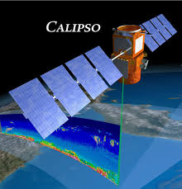

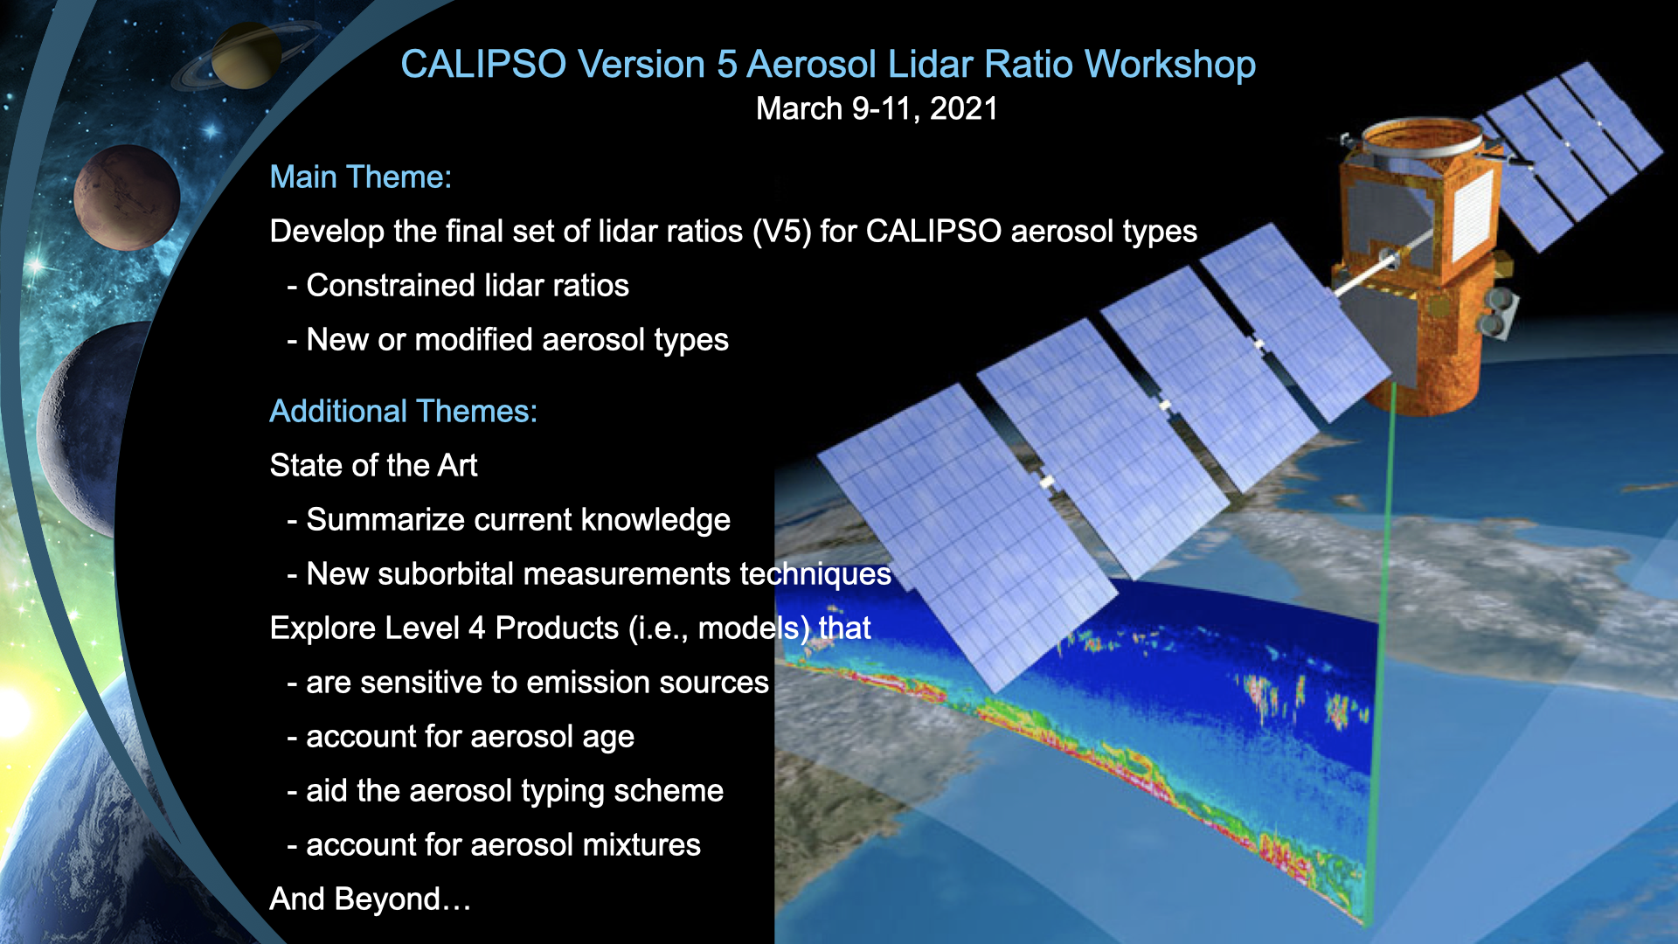
Characterizing a Historic African Dust Plume with CALIOP, MODIS, SEVIRI, and GEOS
Hongbin Yu
NASA Goddard Space Flight Center
Qian Tan, Lillian Zhou, Yaping Zhou, Huisheng Bian, Mian Chin, Claire Ryder, Robert Levy, Yaswant Pradhan, Yingxi Shi, Qianqian Song, Zhibo Zhang, Peter Colarco, Dongchul Kim, Lorraine Remer, Tianle Yuan, Olga Mayol-Bracero, Brent Holben
“Observation and modeling of a historic African dust intrusion into the Caribbean Basin and southern U.S. in June 2020”
submitted to the Atmospheric Chemistry and Physics

Slide 2
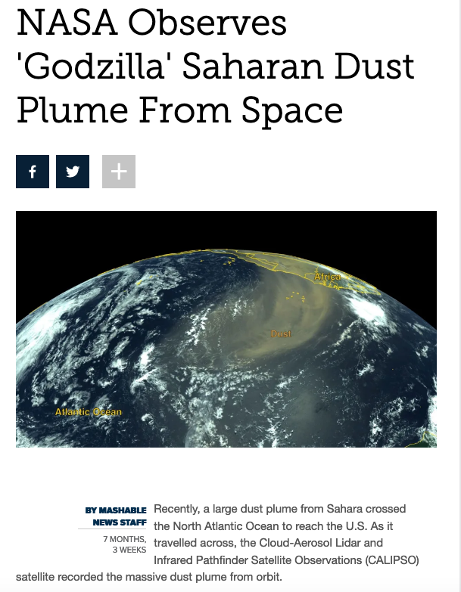
“A Dust Plume to Remember”
A portrait from 1.5 million miles above the Earth surface by EPIC/DSCOVR (https://epic.gsfc.nasa.gov)

Slide 3
Dust intrusion degraded U.S. air quality
Hazardous AQ in Puerto Rico
453
EPA
WHO
highest PM₁₀ since 1994
20% (6/26) and 41% (6/27) of EPA sites in 9 southern states observed PM_{2.5} exceeding the AQ standard.

Slide 4
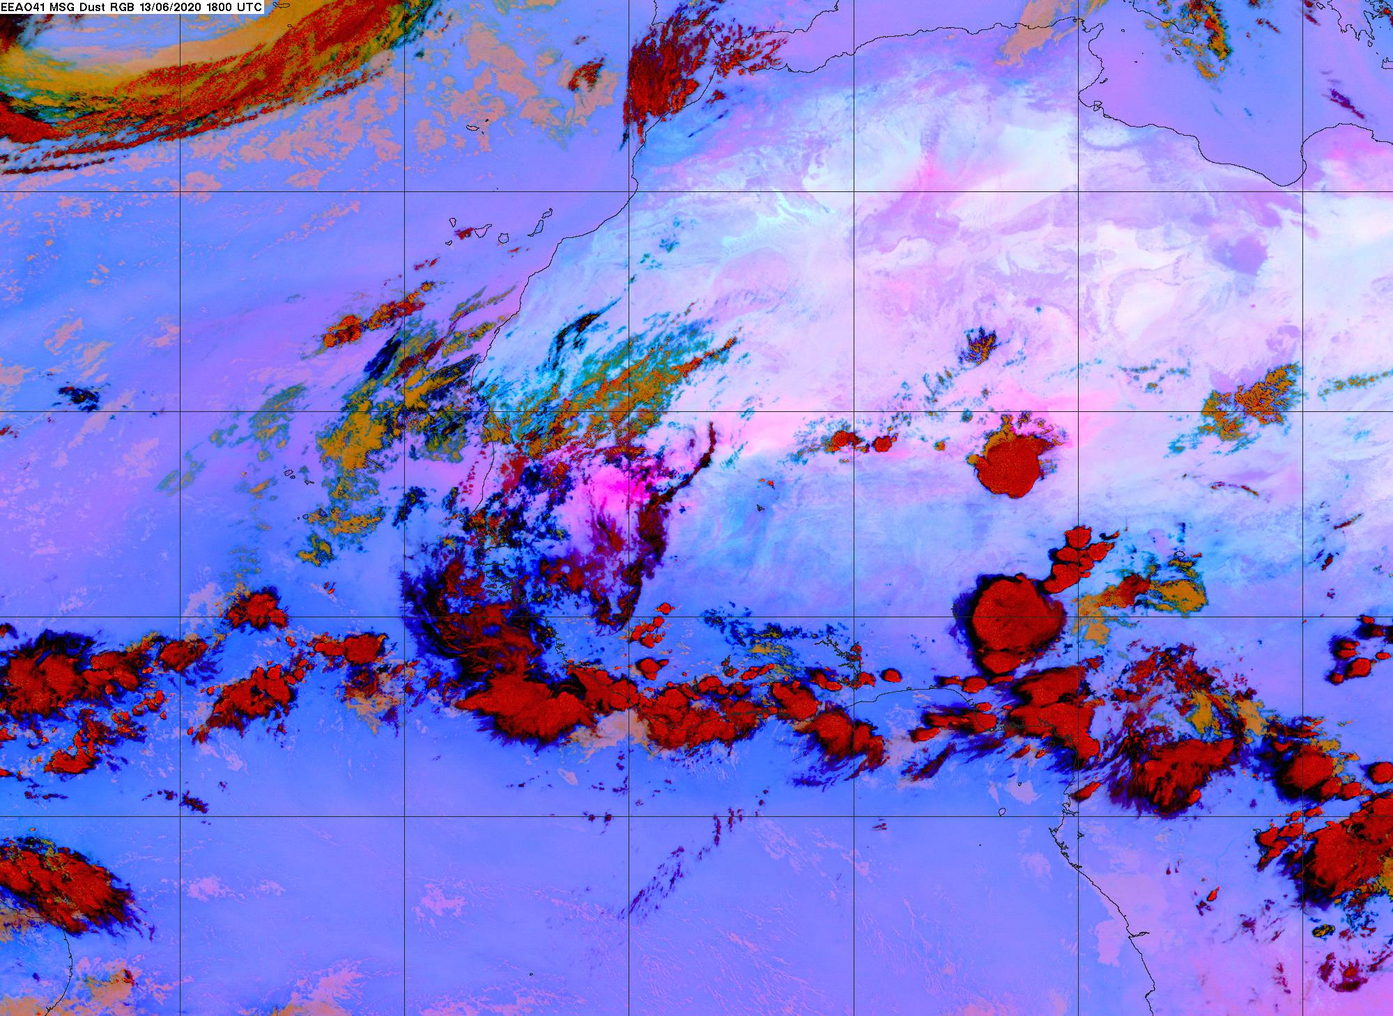
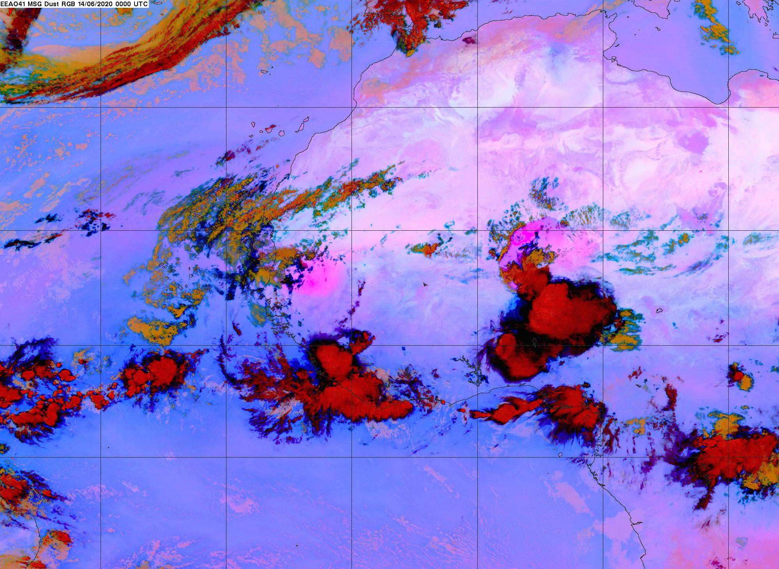
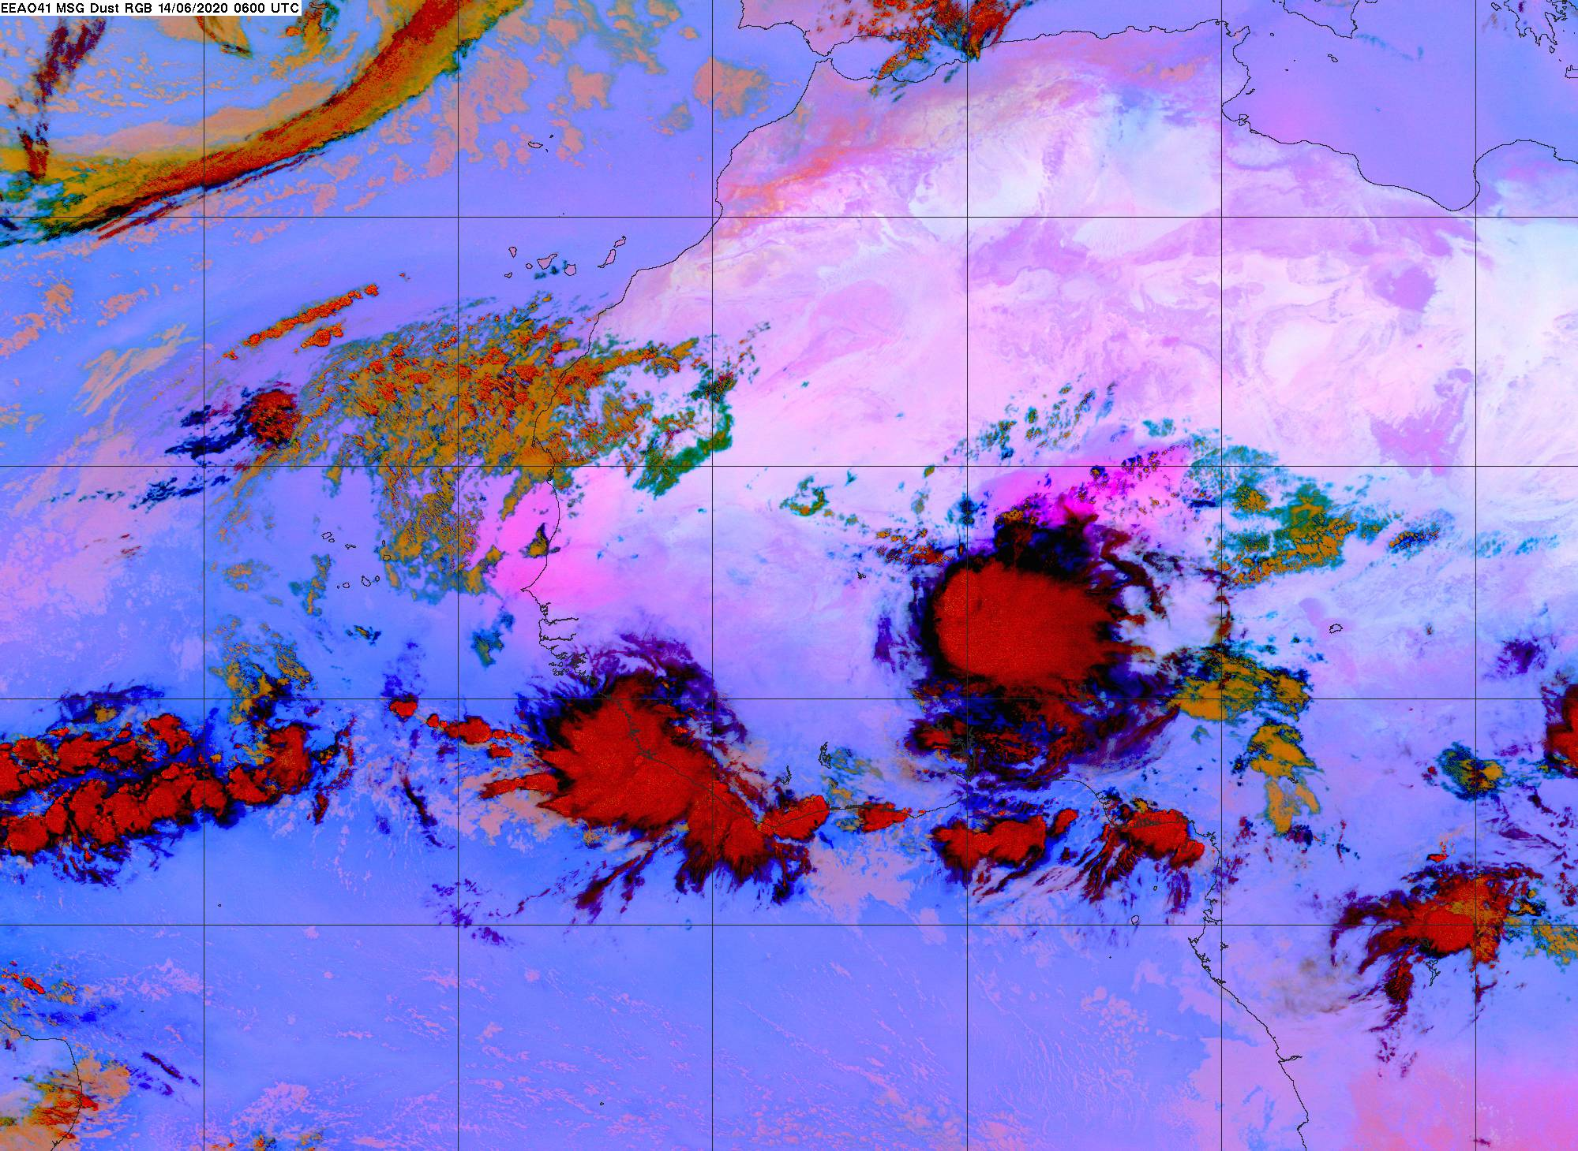
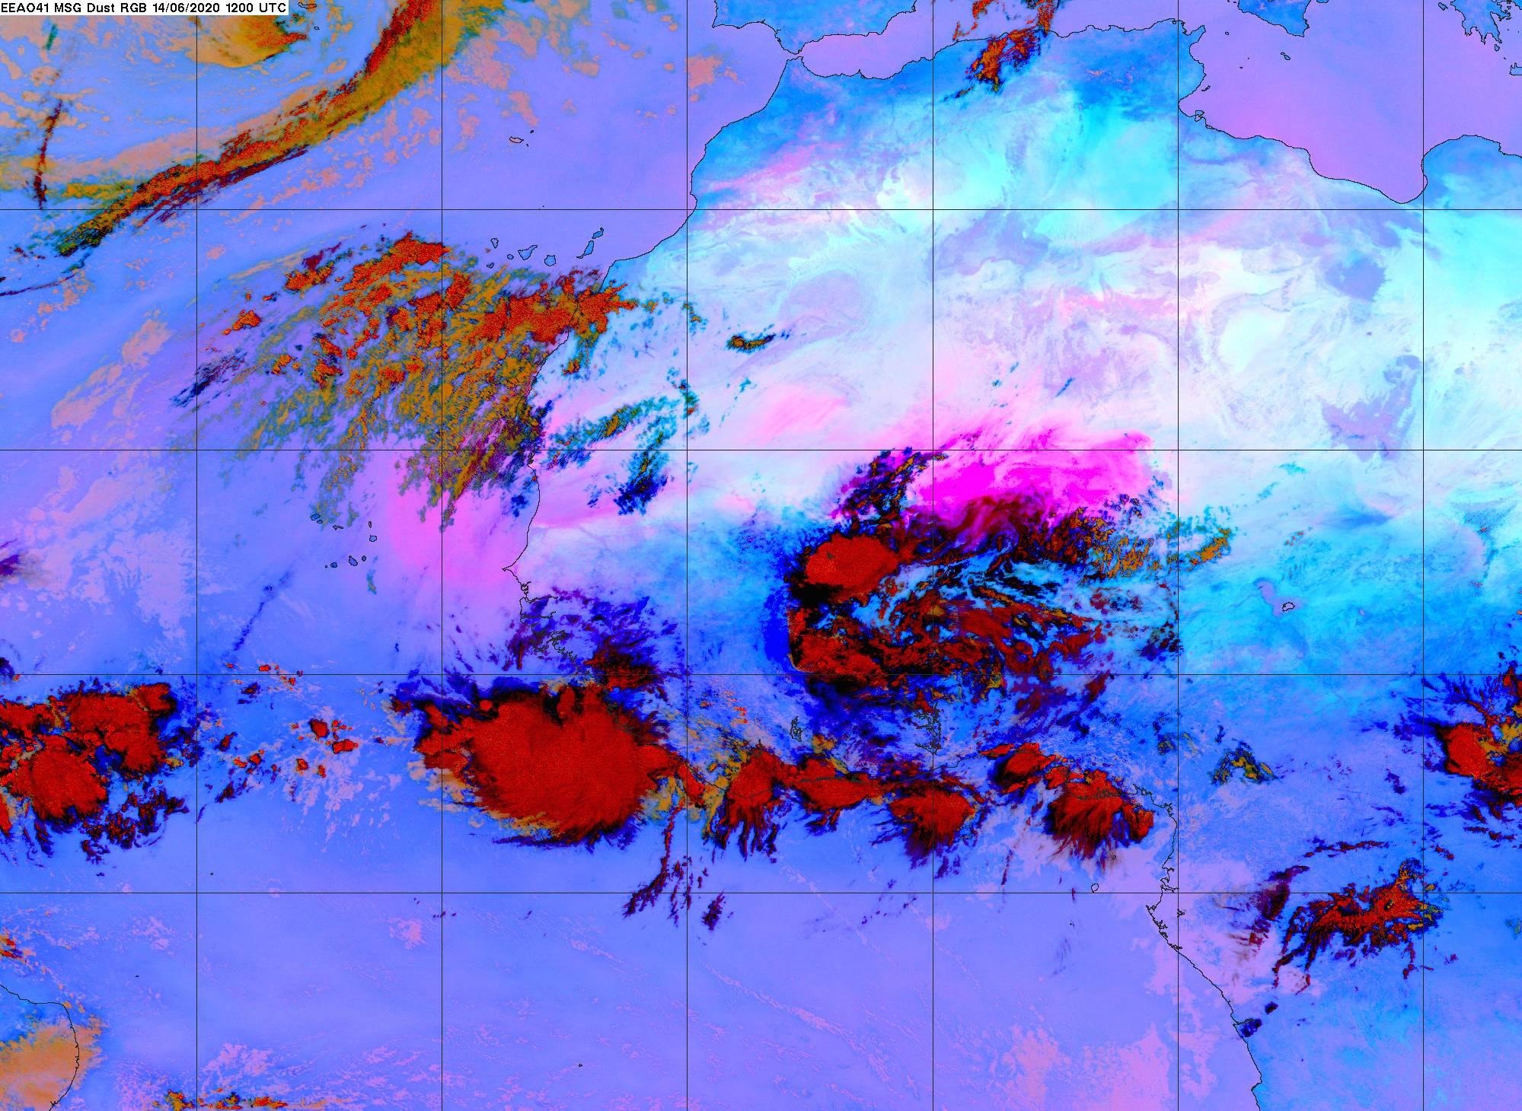
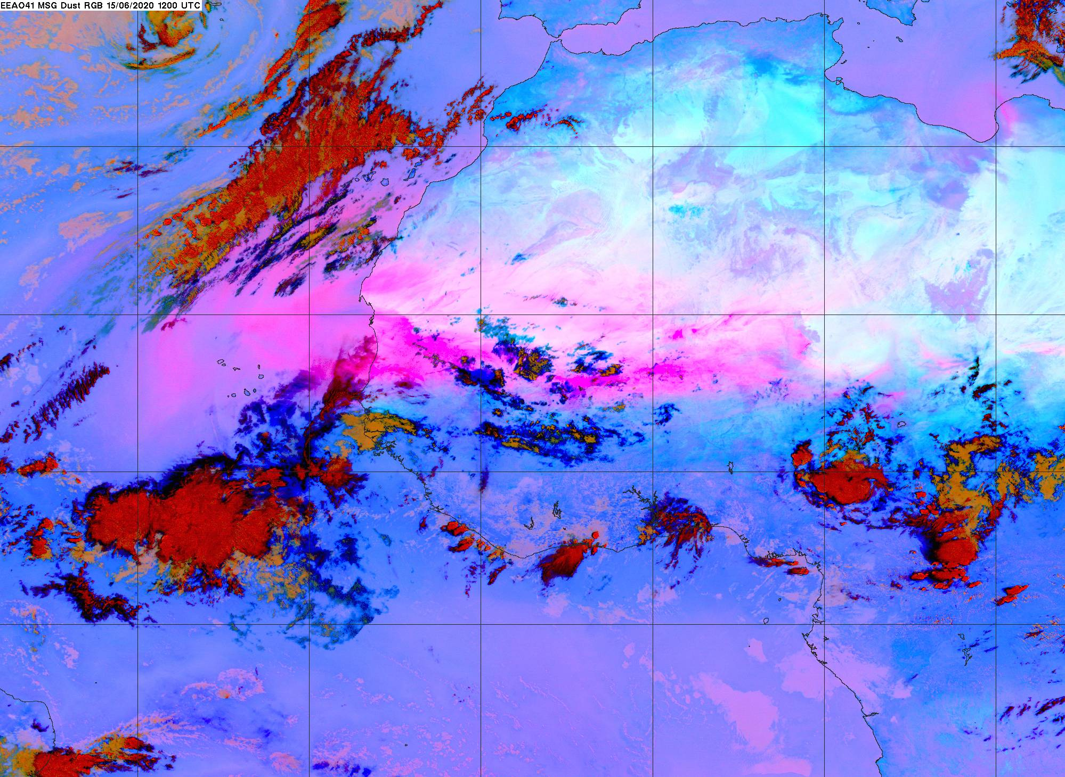
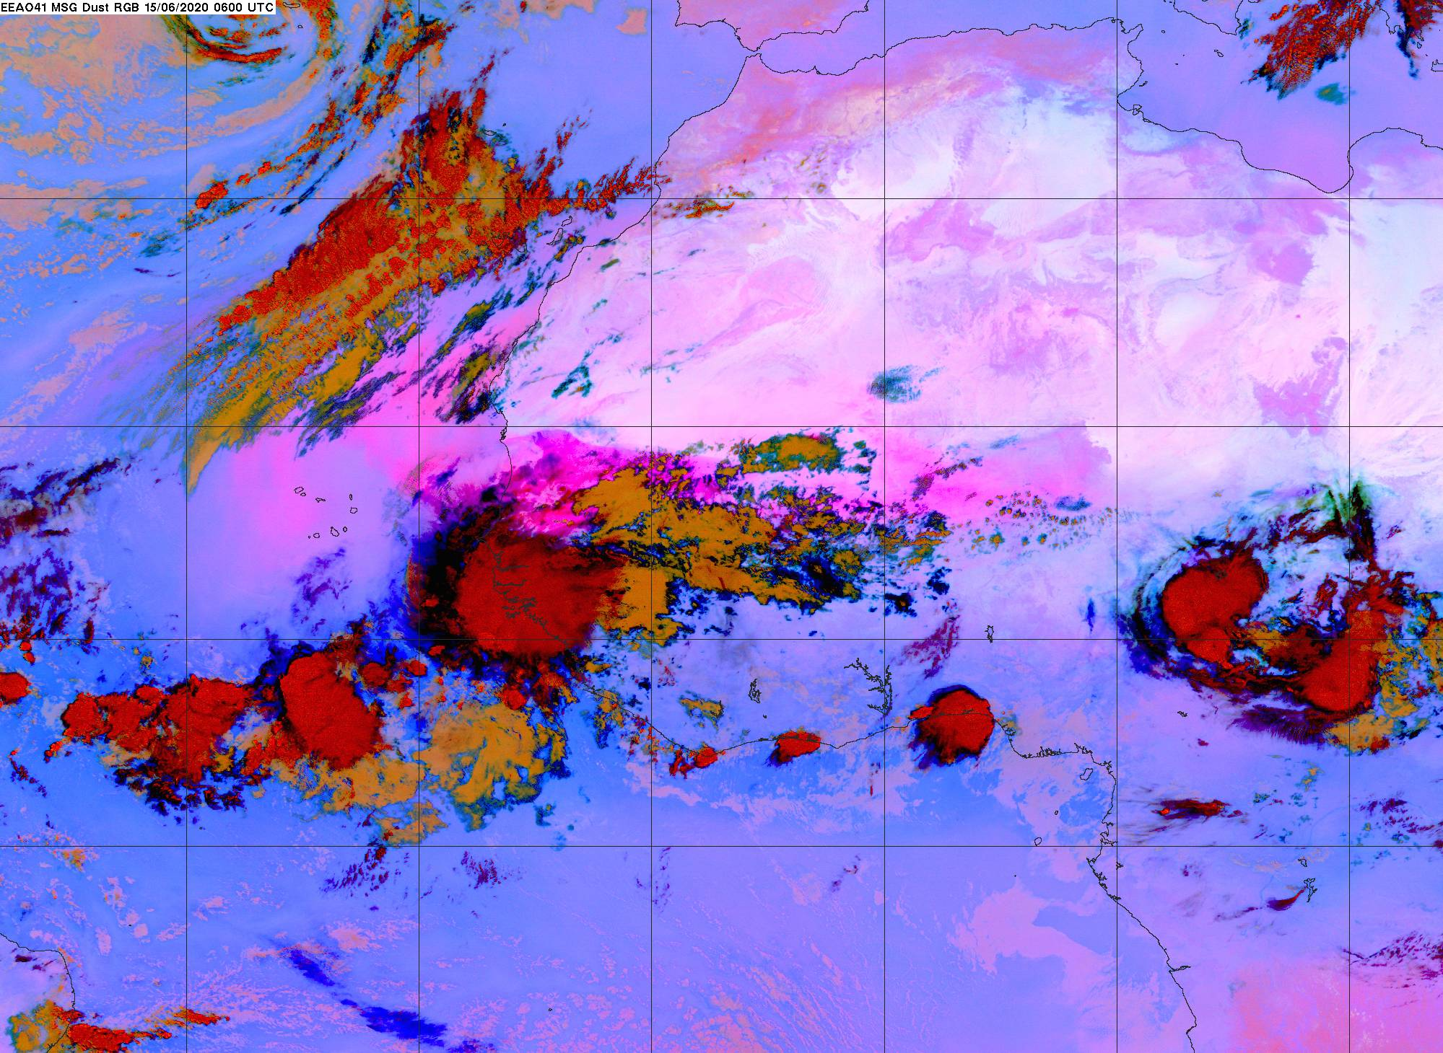
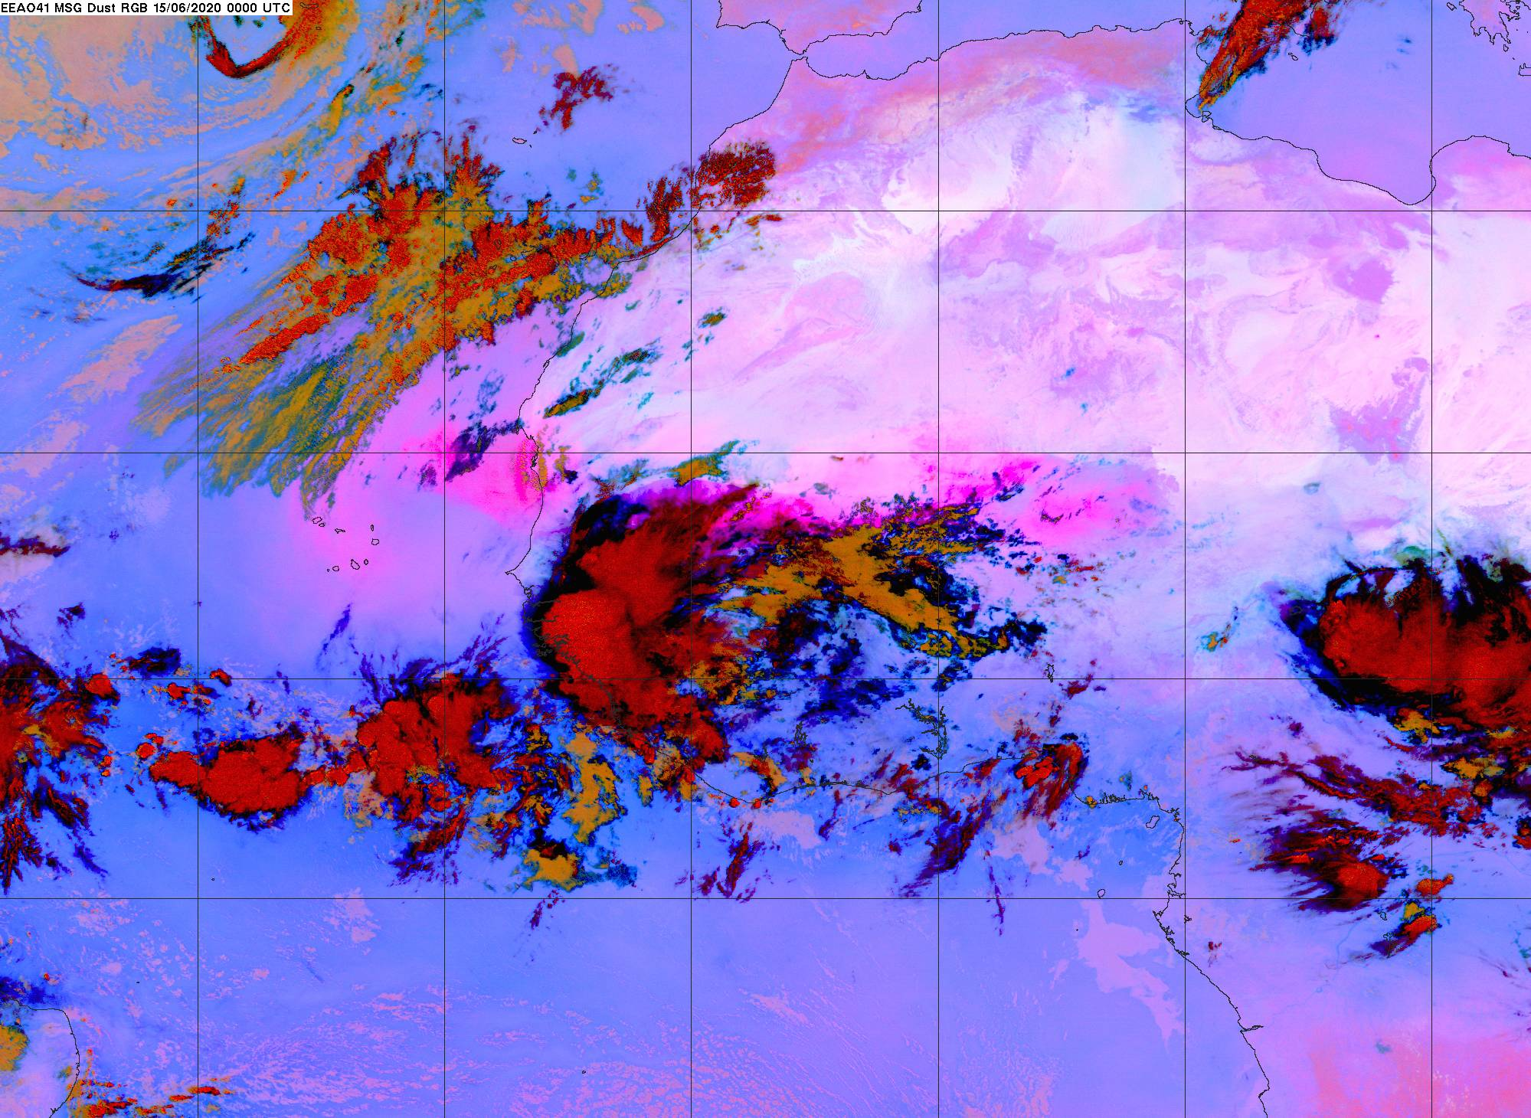
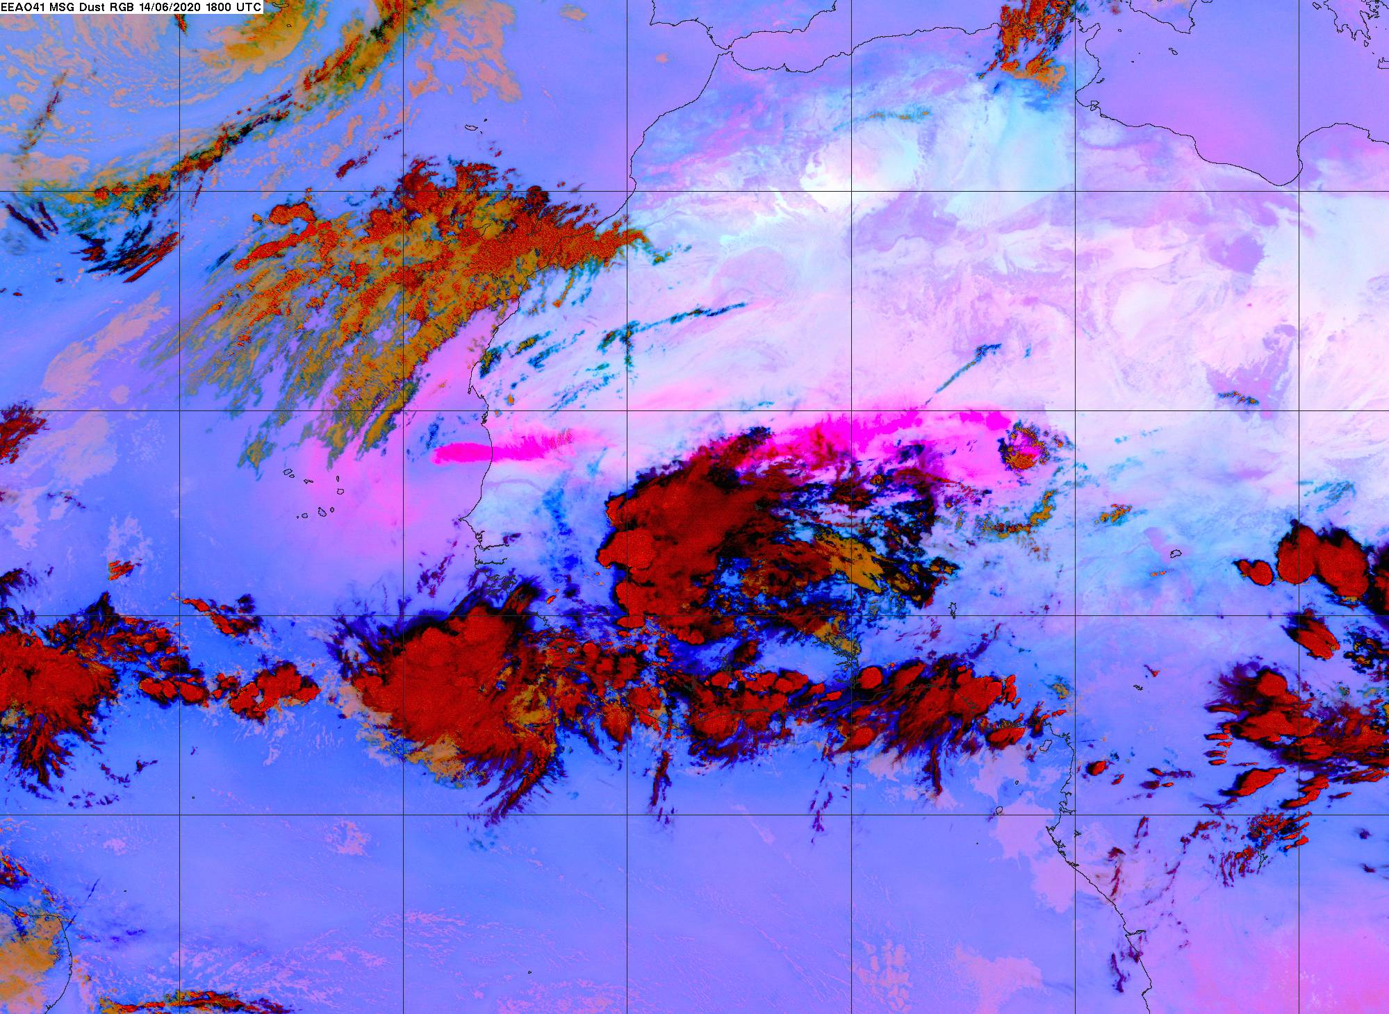
Haboobs - Major Dust Source
6/14 18:00
6/14 00:00
6/14 06:00
6/14 12:00
6/15 12:00
6/15 06:00
6/15 00:00
6/14 18:00

Slide 5
Historic Dust Intrusion
The dust plume is record-breaking event in tropical Atlantic basin over the past two decades.

Slide 6
Recirculation in West Africa made it historic
Dust loading near source is not historic
On June 14-16, the Bermuda-Azores High shifted northward and a Low system formed over the Azores, leading to strong meridional winds and hence the dust accumulation/ recirculation in the coastal region.

Slide 7
Dust accumulation in African coast
SEVIRI: Spinning Enhanced Visual and InfraRed Imager

Slide 8
Vertical Structure of Dust Plume - CALIOP
Caribbean Sea
African Coast
Top at 4km, bottom at surface
Top at 6-8km, bottom elevated
Plume descending rate at ~500 m/d, plume traveling speed at ~1000 km/d

Slide 9
Evolution of Dust Properties – CALIOP Analysis
DR in the free atmosphere (>2km) remains nearly constant in the vertical and along the trans-Atlantic transport.
daytime data are noisy and biased high, but show similar results
CR decreases somewhat from Africa to Caribbean – consistent with preferential removal of coarse particles
CR increases with altitude – retrieval issue or any physics?
PDR
CR
Ext

Slide 10
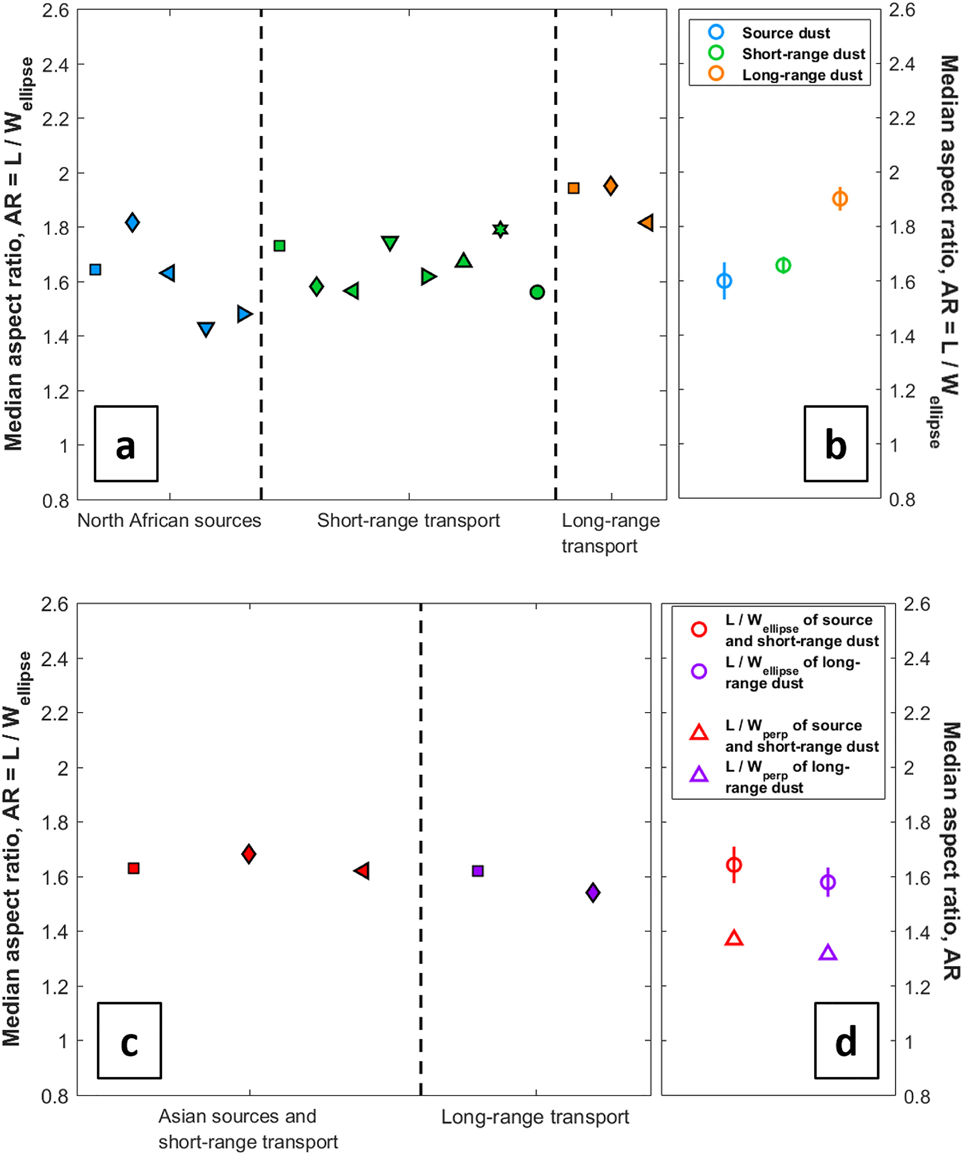
Are CALIOP PDR data consistent with other studies?
Consistent with
  Liu et al. (2008) ~0.31 during the trans-Atlantic transport
  SALTRACE: vertically uniform
  a theoretical calculation when accounting for dust-absorption induced convection / vertical mixing
with mixing (solid)
PDR
no mixing (dashed)
(Gasteiger et al., ACP, 2017)
Inconsistent with
  particle-shape induced “sorting” effect
  observed increasing asphericity (AR)
(Huang et al., GRL, 2020)
(Yang et al., GRL, 2013)

Slide 11
Evolution of dust size during the transport observed by MODIS?
Fine-mode fraction or FMF - a fraction of sub-micron aerosol contributing to AOD at 550 nm
?
MODIS FMF increases with increasing transport distance (+0.03/10deg) – dust particles finer due to preferential removal of coarse particles?
AERONET FMF:
higher than MODIS in African coast
no discernable change from Africa to Caribbean
increase from Caribbean to the Gulf
Gulf of Mexico
Caribbean
African coast
Tallahassee | Miami | La Parguera | San Juan | Guadeloup | Barbados | Cape Verde | Dakar | Tamanrasset | Site
0.25 | 0.27 | 0.19 | 0.20 | 0.33 | 0.22 | 0.19 | 0.21 | 0.17 | FMF

Slide 12
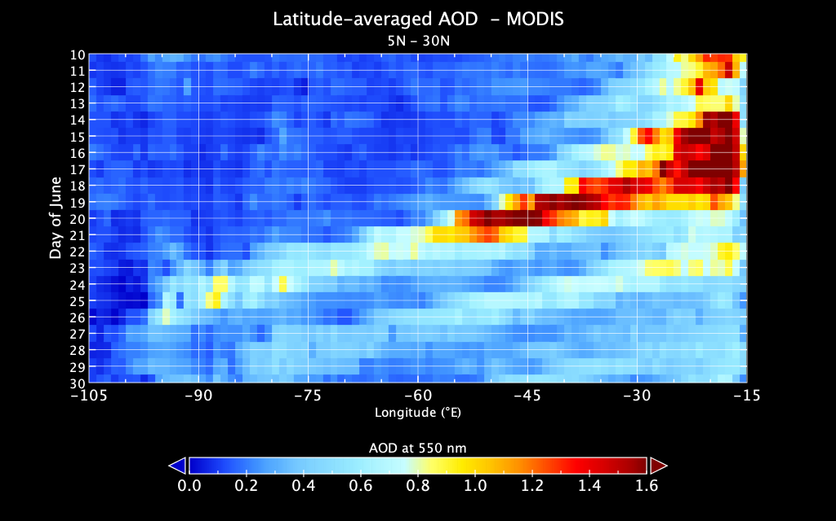
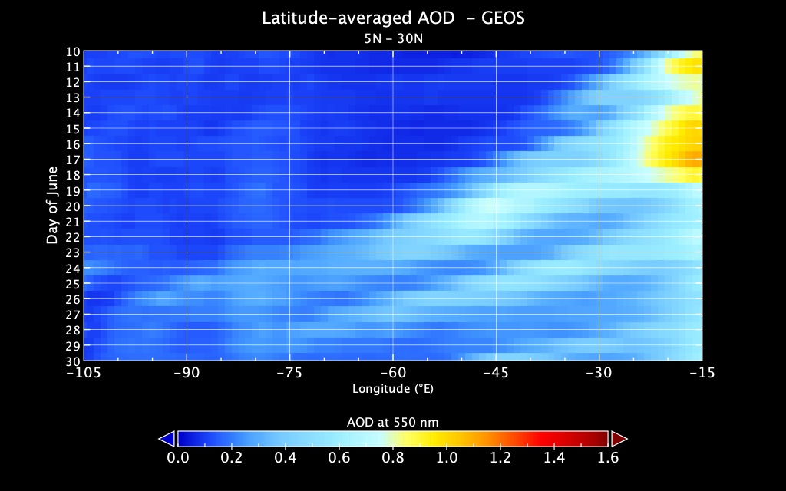
Satellites vs GEOS – AOD
MODIS
GEOS
Day of June
Day of June
Longitude
Longitude
GEOS underestimated AOD by factors of 2-4 for the “Godzilla” plume.
GEOS did better job for the secondary plume (~2x).

Slide 13
Satellite vs. GEOS – Saharan Desert
2020-06-14
GEOS underestimated AOD of Nigerian dust sources.
GEOS didn’t raise up adequate dust in haboob to high altitudes, which will affect the ensuing long-range transport.

Slide 14
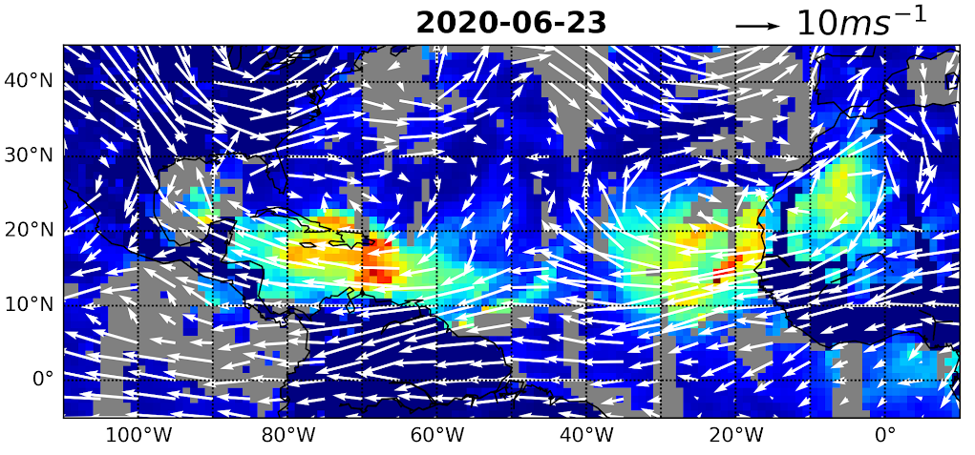
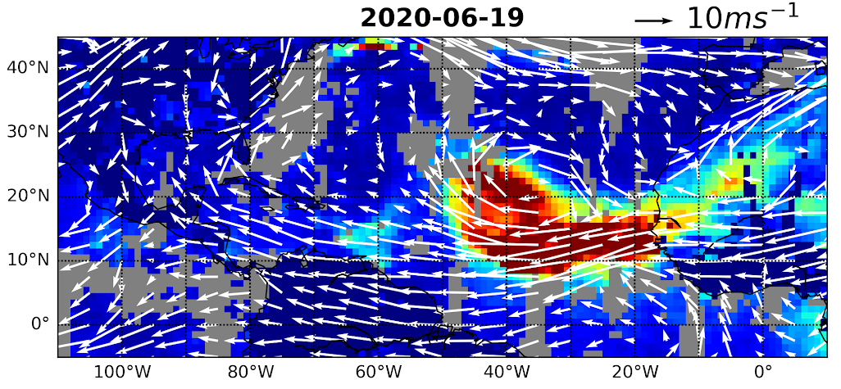
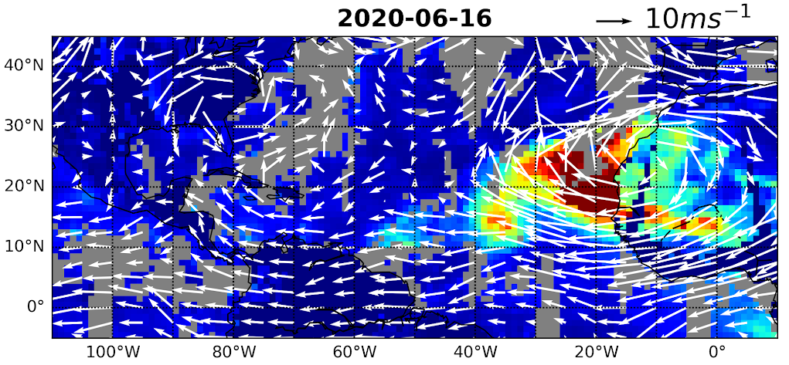
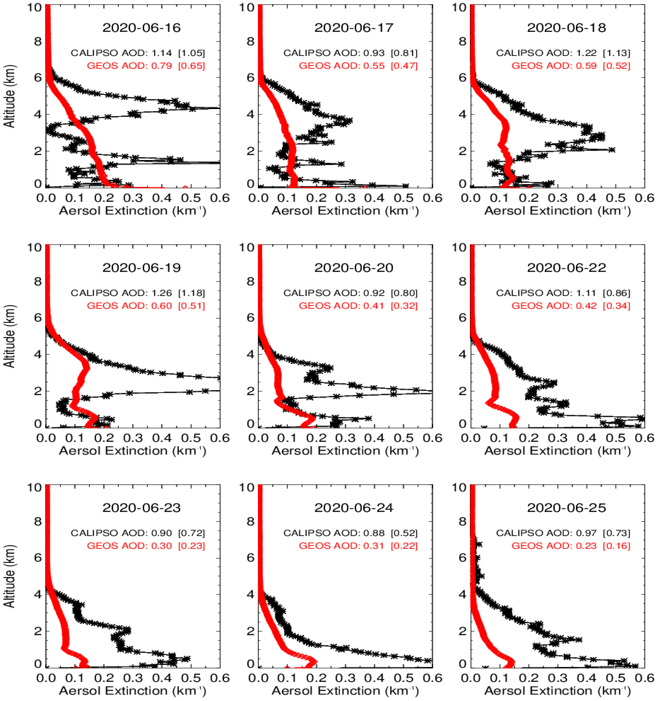
Satellites vs GEOS – Vertical Distribution
GEOS misses the elevated dust plume, which can be attributed to the inadequate dust lifting in source.
CALIOP to GEOS AOD ratio: 1.5 in African coast, 2 in mid-Atlantic, and 3 in Caribbean
Assimilating AOD cannot correct model’s issues in vertical structure. Instead, it could put too much dust in lower layer and also artificially enhance dust deposition.

Slide 15
Summary: what to remember about the Godzilla dust plume
The historic dust intrusion significantly degraded air quality.
Haboobs and unique synoptic systems are responsible for this record-breaking event.
  Dust was mixed up to 6-8 km, as CALIOP data show.
  Dust was accumulated in African coast for about four days before heading westwards.
Particulate depolarization ratio remains constant in the vertical and during the trans-Atlantic transport. For size change, CALIOP and MODIS agree to some extent.
GEOS model captured the plume track quite well. However, the model has several deficiencies:
  missing / underestimating haboob dust sources
  not lifting enough dust to high altitudes
  substantially underestimating magnitude of the dust intrusion

Slide 16

Any questions?

